Slide 1
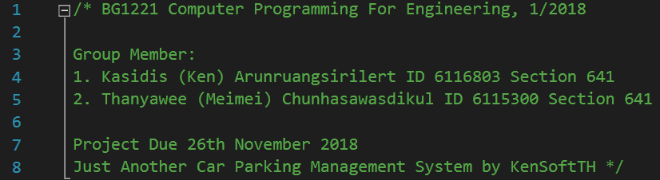
Car Parking System

Slide 2
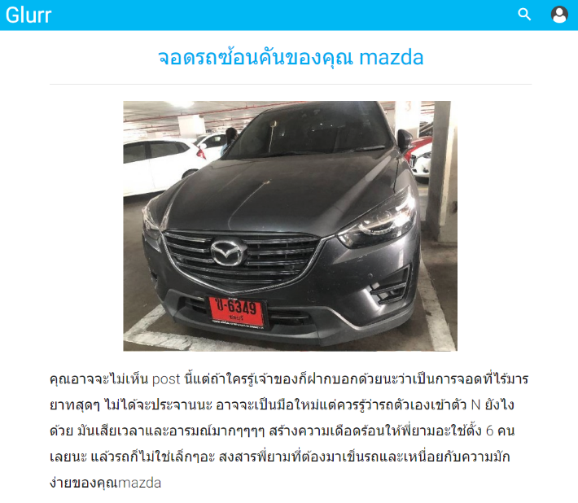
Why Car Parking Project?

Slide 3
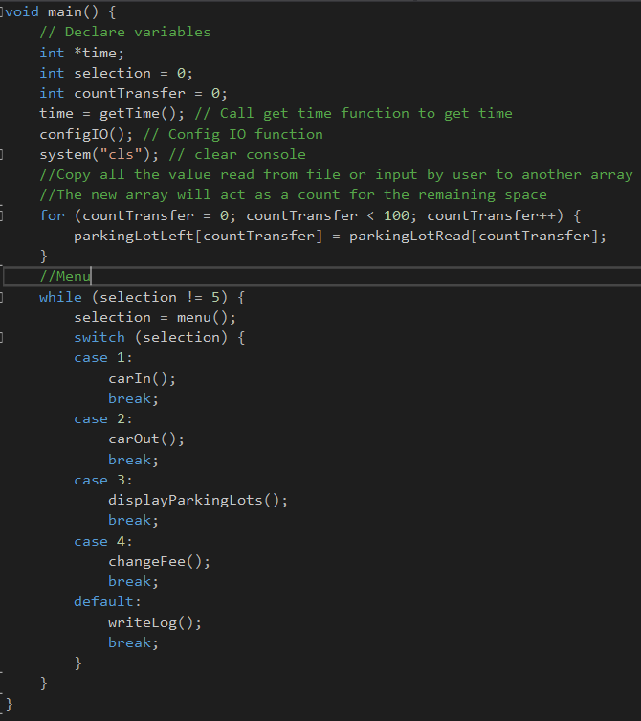
Main Function

Slide 4
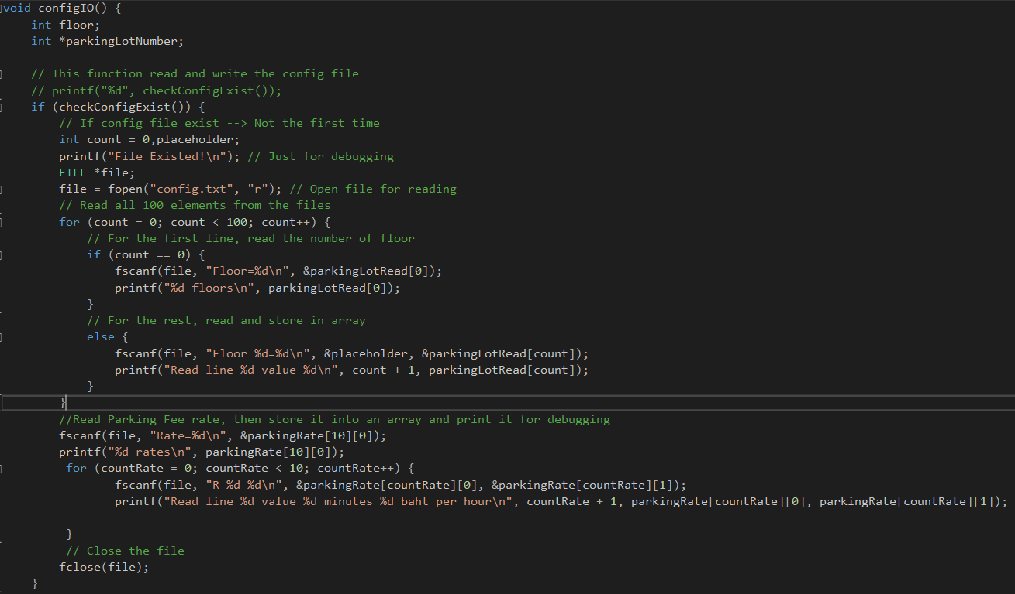
Config IO Function

Slide 5
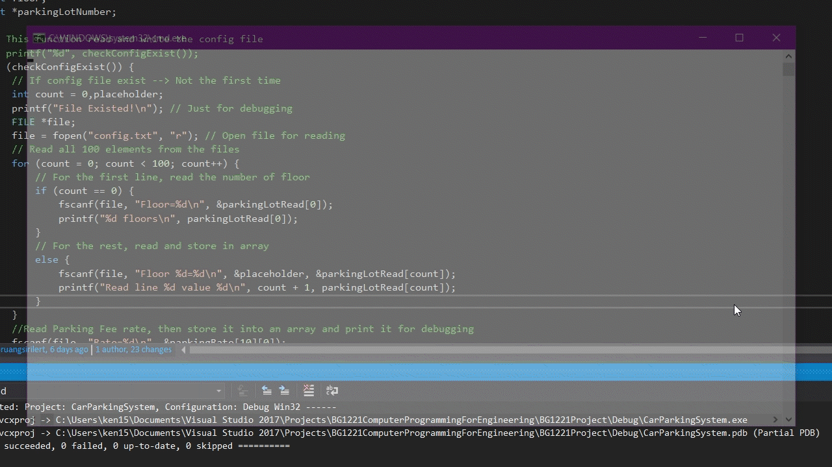

Slide 6
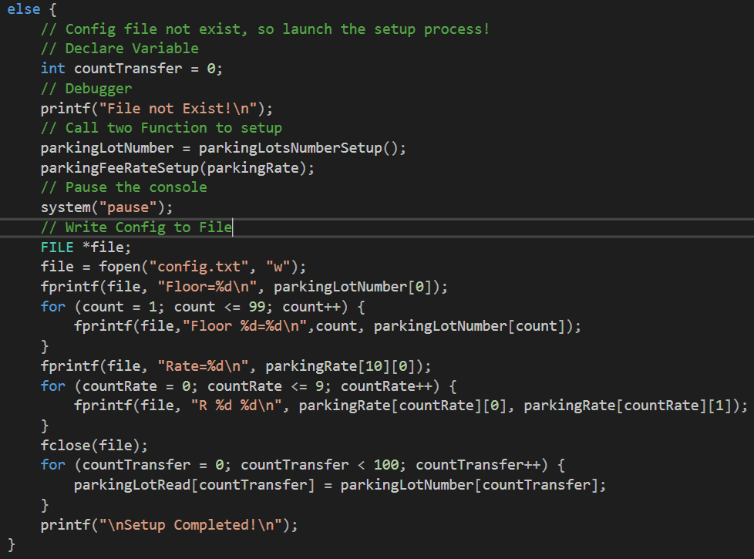
Config IO Function

Slide 7
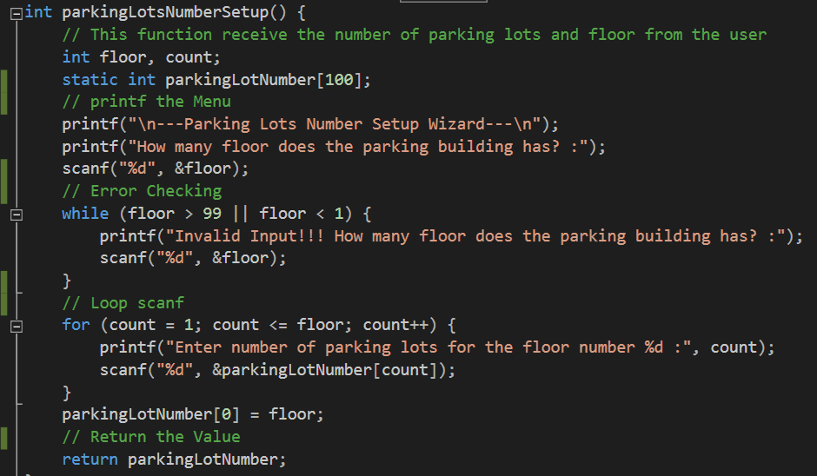
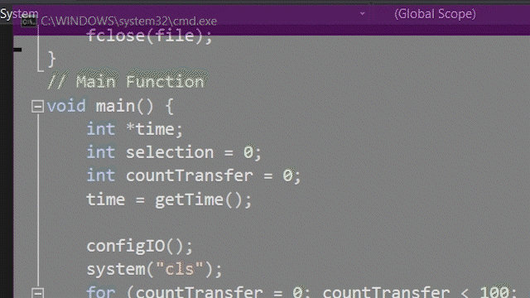
Parking Lots Number Setup Function

Slide 8
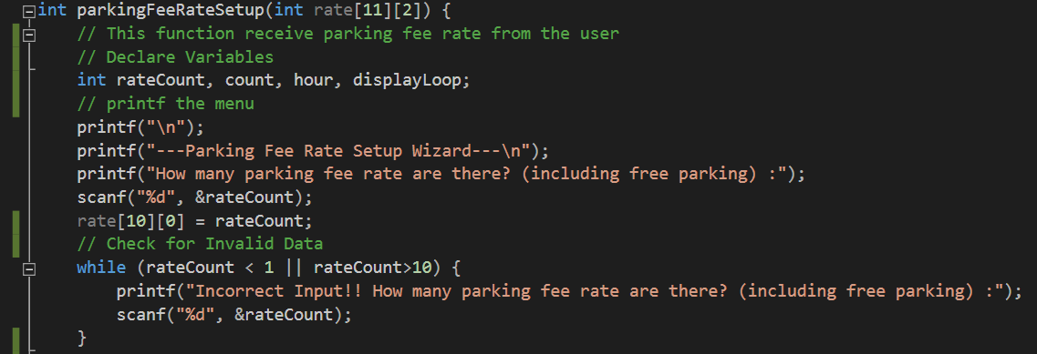
PARKING FEE RATE SETUP Function

Slide 9
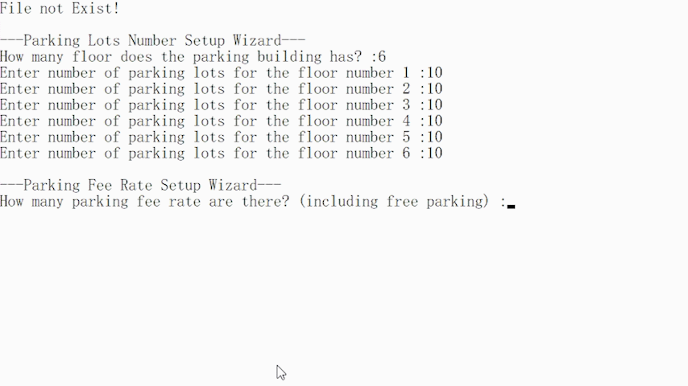

Slide 10
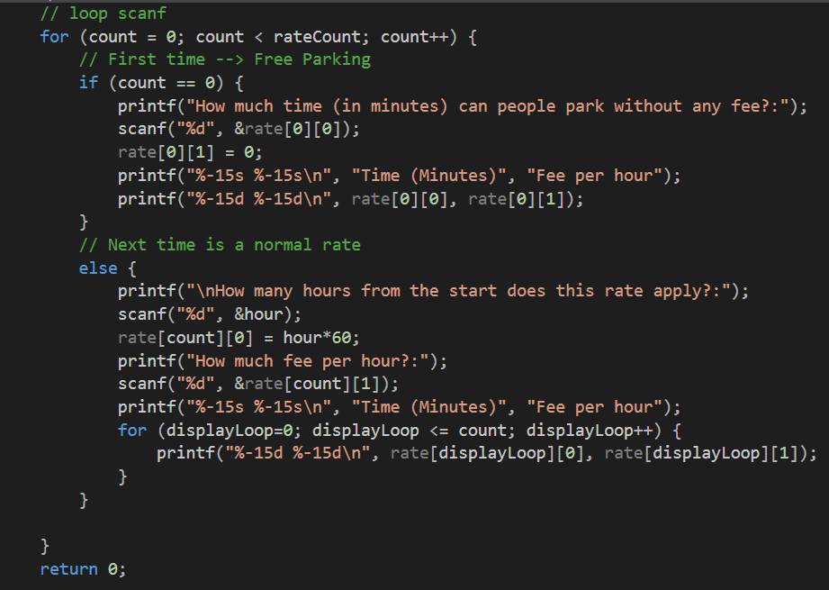

Slide 11
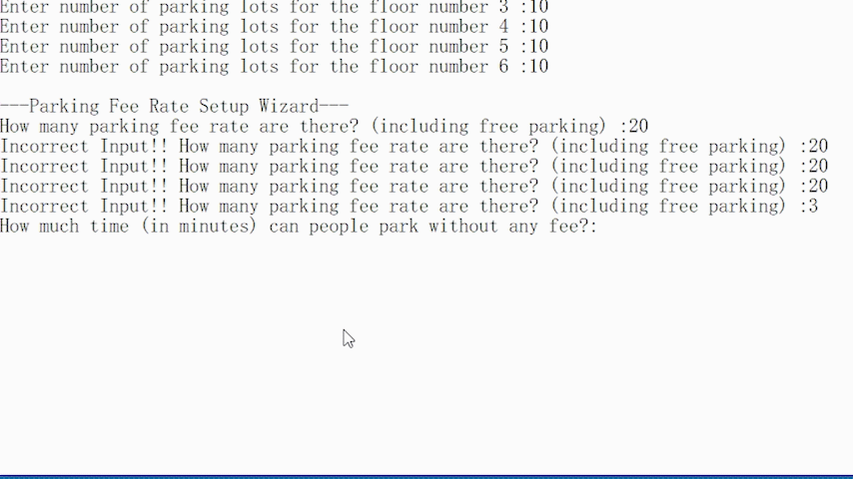

Slide 12
Main Function

Slide 13
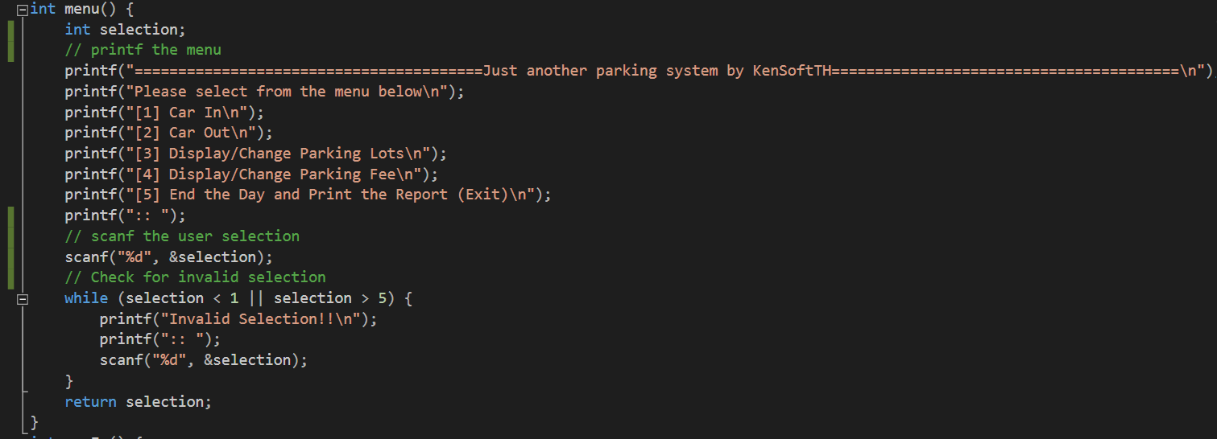
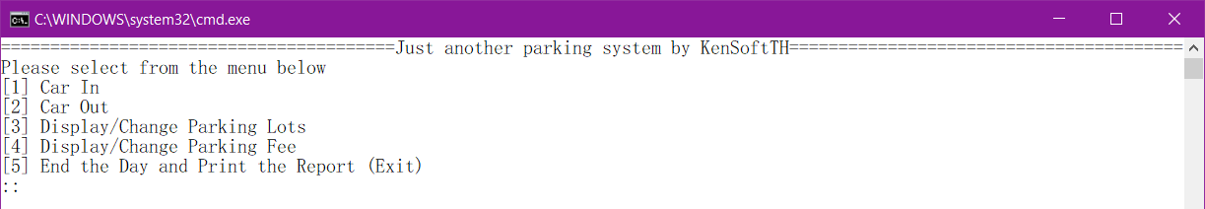
Menu Function

Slide 14
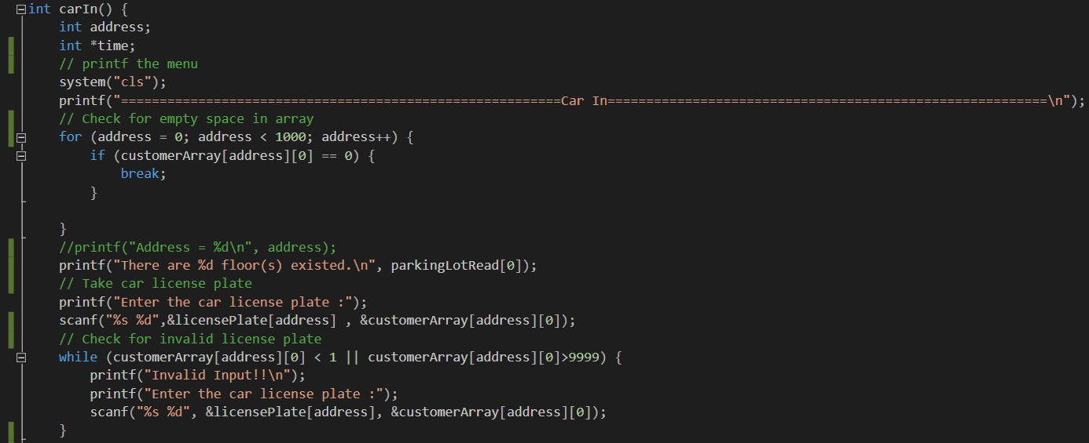
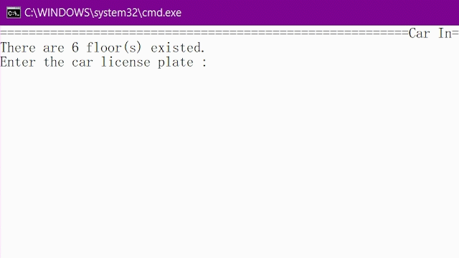
Carin Function

Slide 15
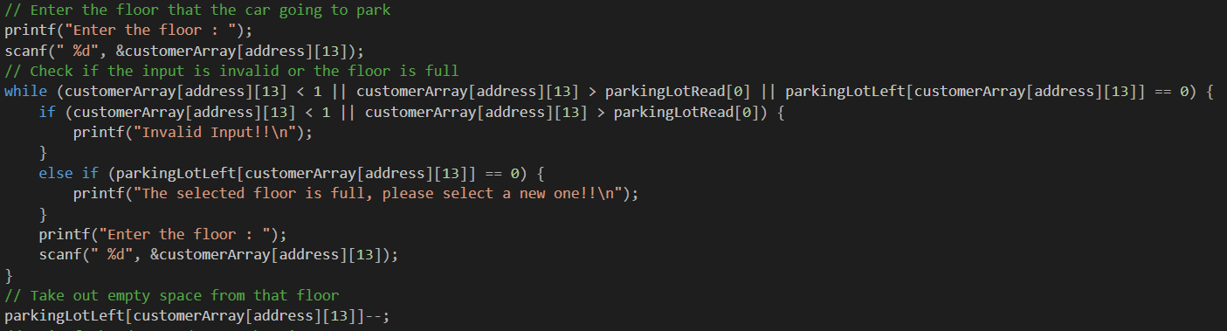
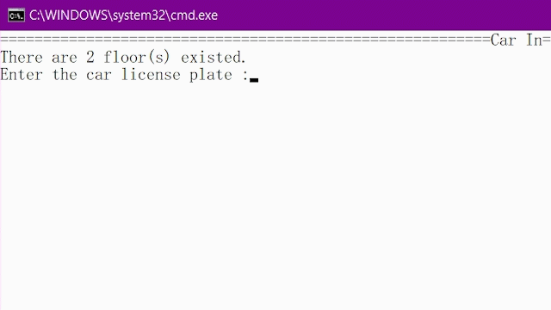
Car in Function

Slide 16
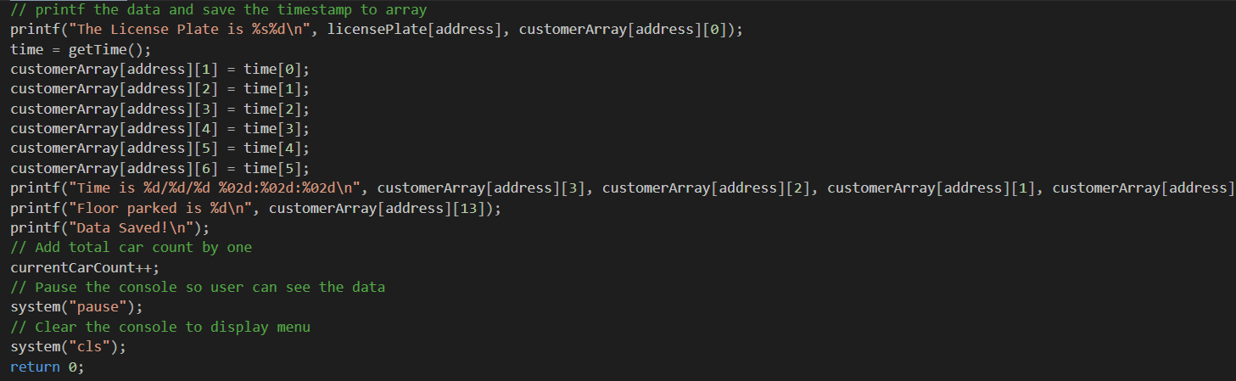
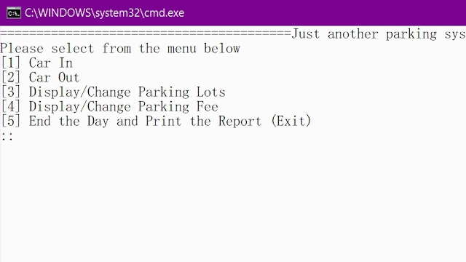
Car in Function

Slide 17
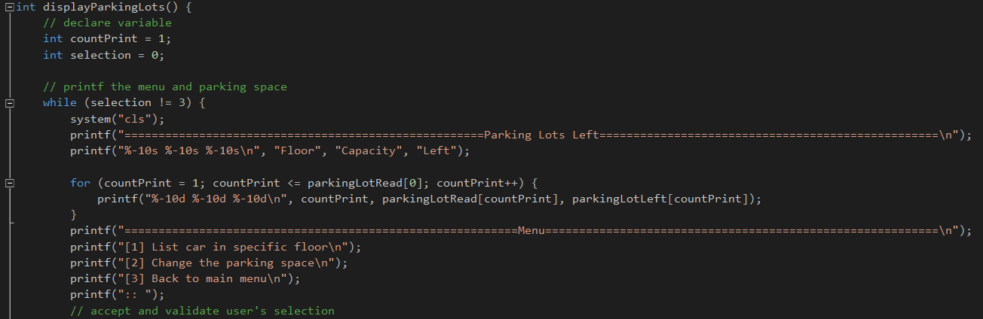
CAPACITY CHECK FUNCTION

Slide 18
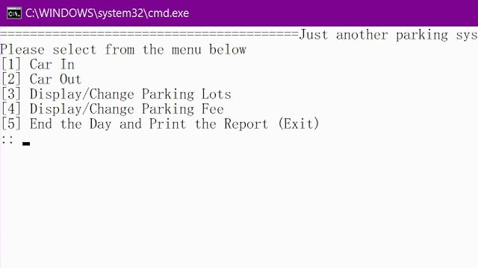
CAPACITY CHECK FUNCTION

Slide 19
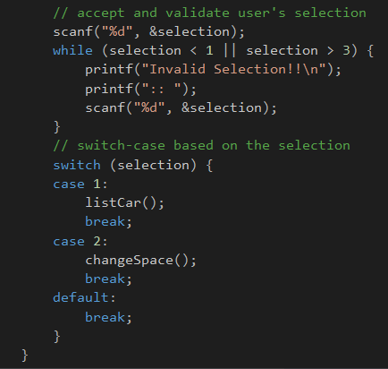
CAPACITY CHECK FUNCTION

Slide 20
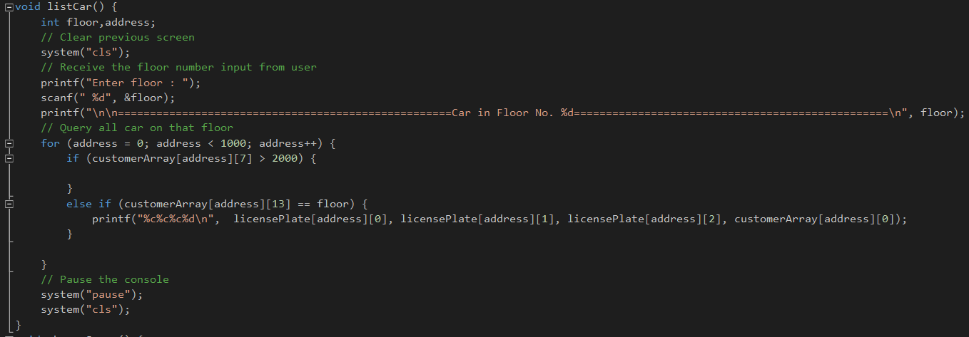
Query car in a floor

Slide 21
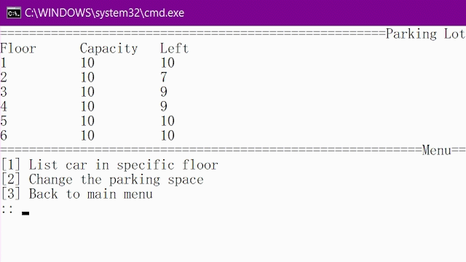
Query car in a floor

Slide 22
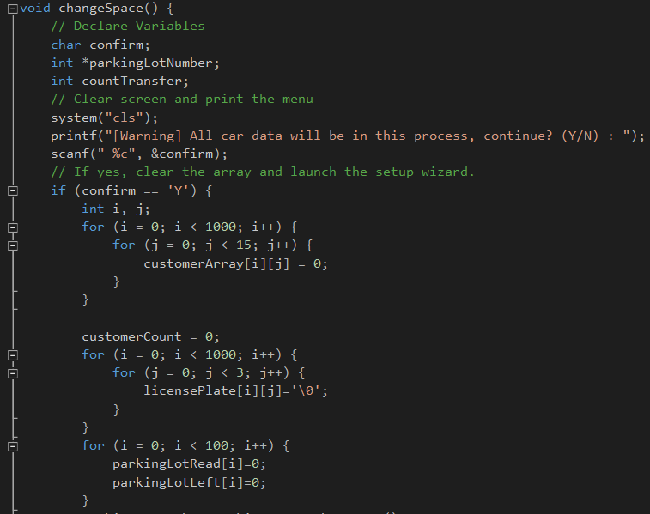
Change Parking Lot Space

Slide 23
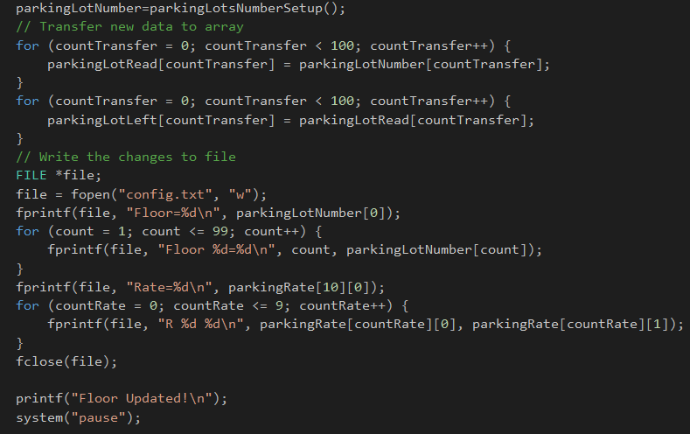
Change Parking Lot Space

Slide 24

Change Parking Lot Space

Slide 25
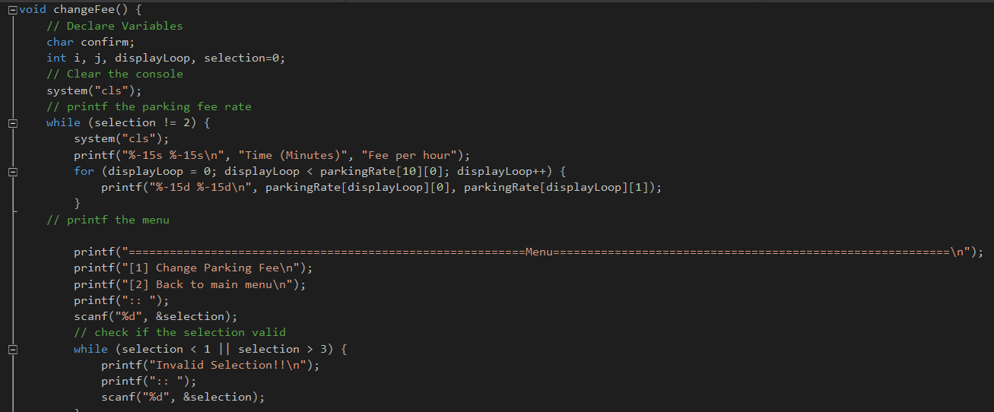
View/Change Parking Rate

Slide 26
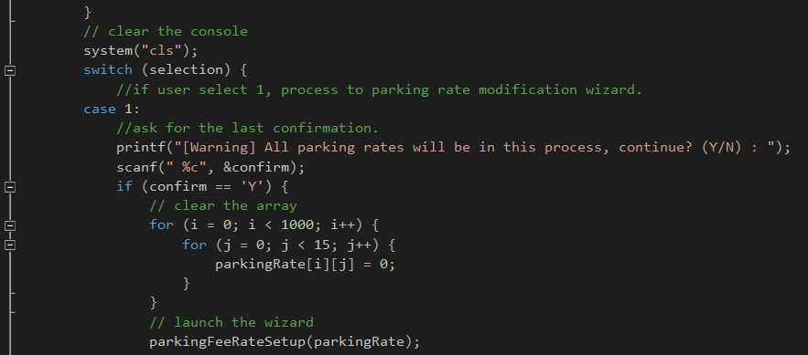
View/Change Parking Rate

Slide 27
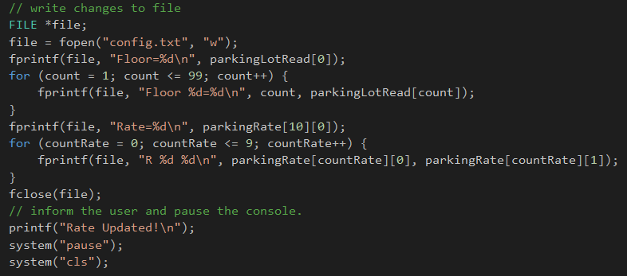
View/Change Parking Rate

Slide 28
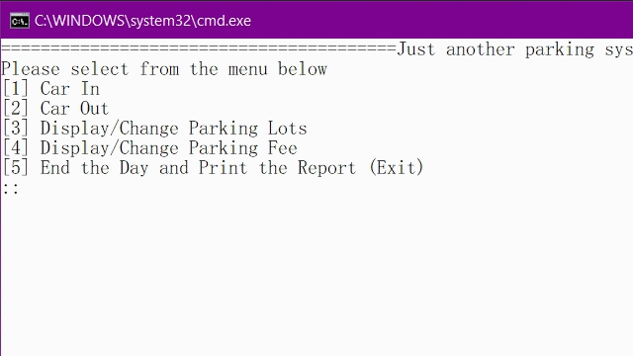
View/Change Parking Rate

Slide 29
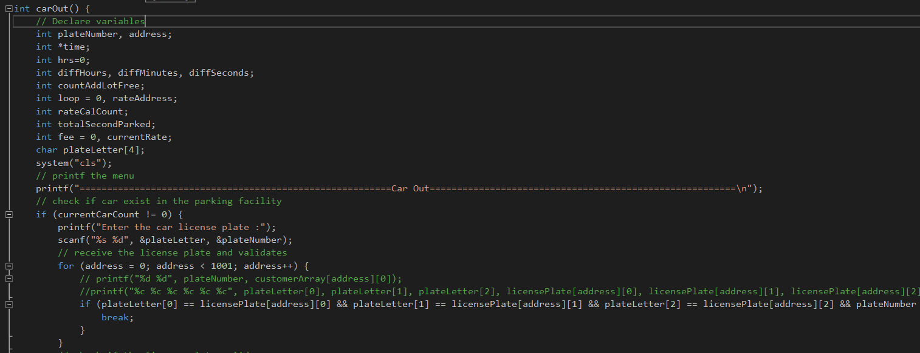
CAR OUT Function

Slide 30
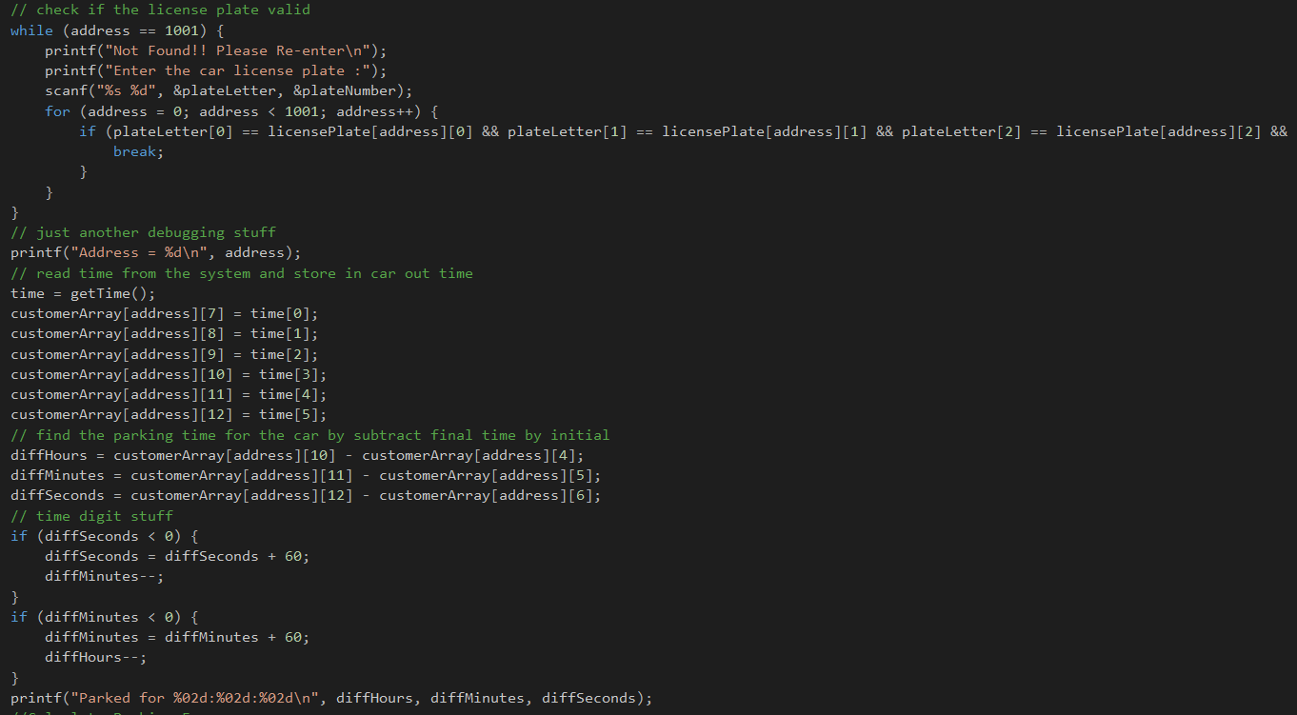
CAR OUT Function

Slide 31
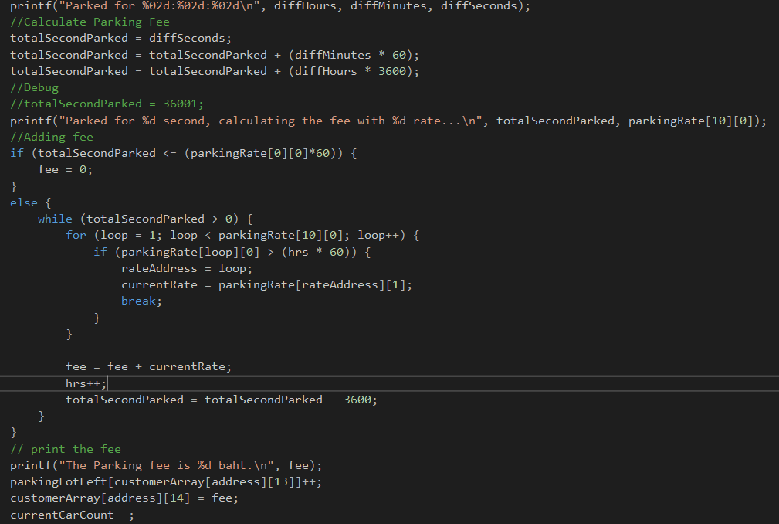
CAR OUT Function

Slide 32
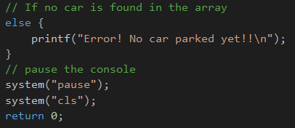
CAR OUT Function

Slide 33
CAR OUT Function

Slide 34
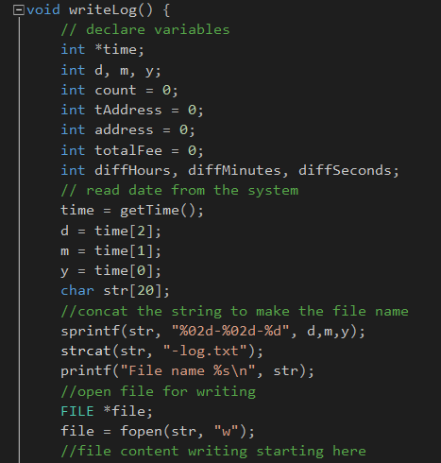
Log writing Function

Slide 35
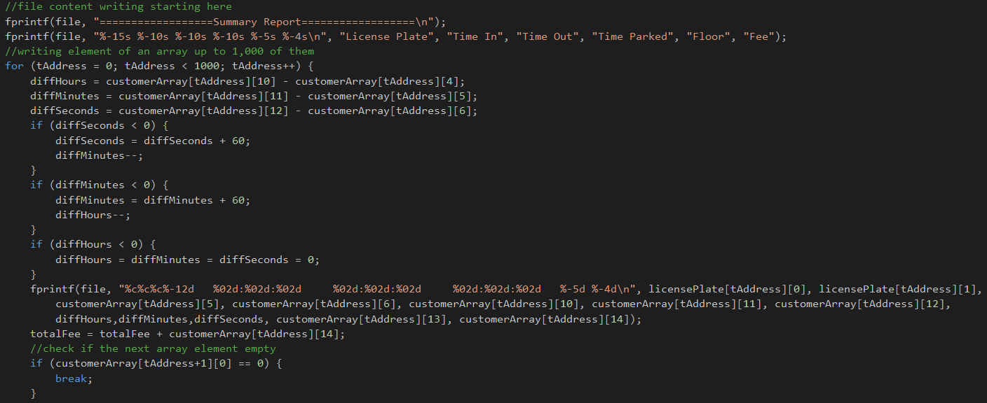
Log writing Function

Slide 36
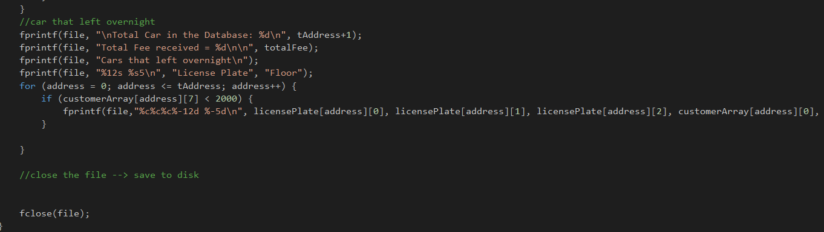
Log writing Function

Slide 37
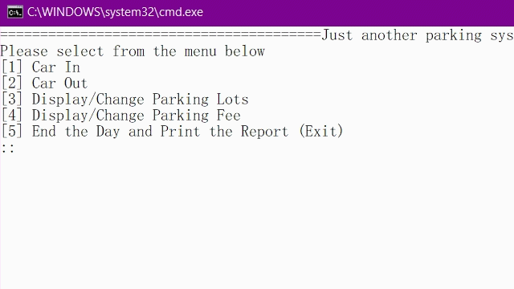
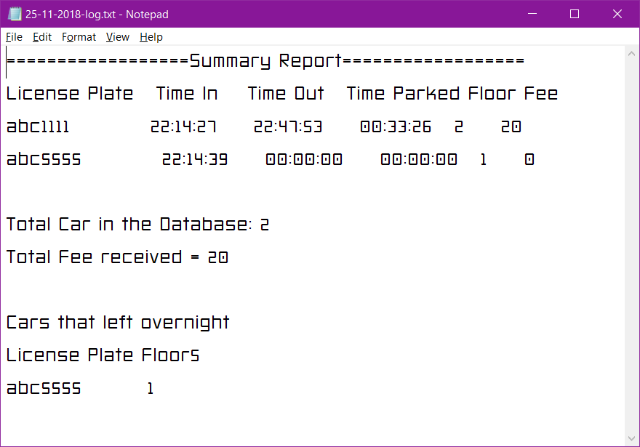
Log writing Function

Slide 38
LIVE DEMO
// Actually just a video :P

Slide 39
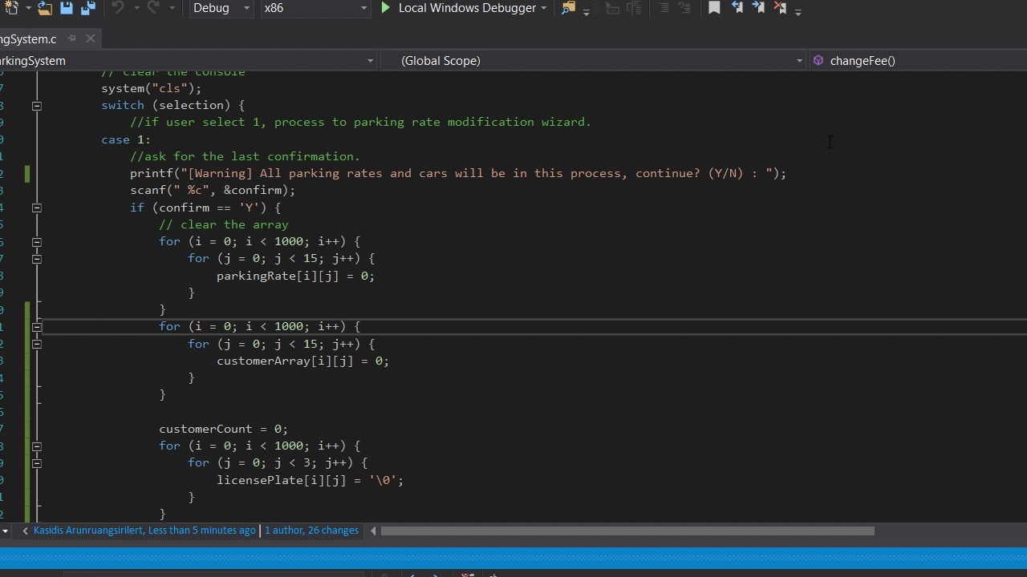

Slide 40
Thank you for listening
http://bit.ly/ABACComPro
https://github.com/KenSoft/BG1221ComputerProgrammingForEngineering

Slide 41
